Slide 1
1.Introduction to Statistical Learning
By Xu Shen
Special thanks to Professor Trevor Hastie and Professor Robert Tibshirani

Slide 2
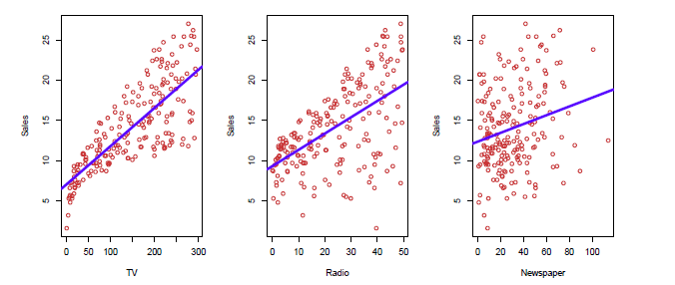
What is statistical learning?
Shown are Sales vs TV, Radio and Newspaper, with a blue linear-regression line t separately to each. Can we predict Sales using these three? Perhaps we can do better using a model.
Sales= f(TV; Radio; Newspaper)

Slide 3
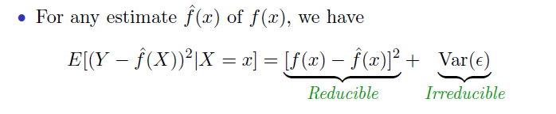
Import concepts derived from an Import Formula

Slide 4
Bias-Variance Tradeoff
Interpretability vs Flexibility
Reducible error vs Irreducible error
Prediction accuracy versus interpretability
Overfit vs underfit
Parsimony versus black-box(Representational Learning)

Slide 5
Data: from low dimension to high dimension
 | Independent Variables | Features | Predictors | Dependent Variables
Participants
Subjects
Observations
Trials

Slide 6
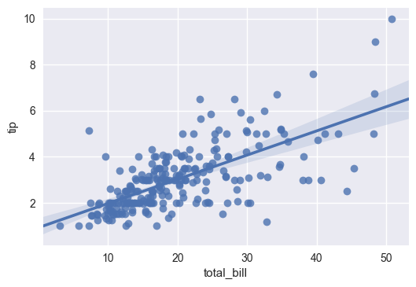

Problem Types-Supervised Learning
Classification
Regression

Slide 7
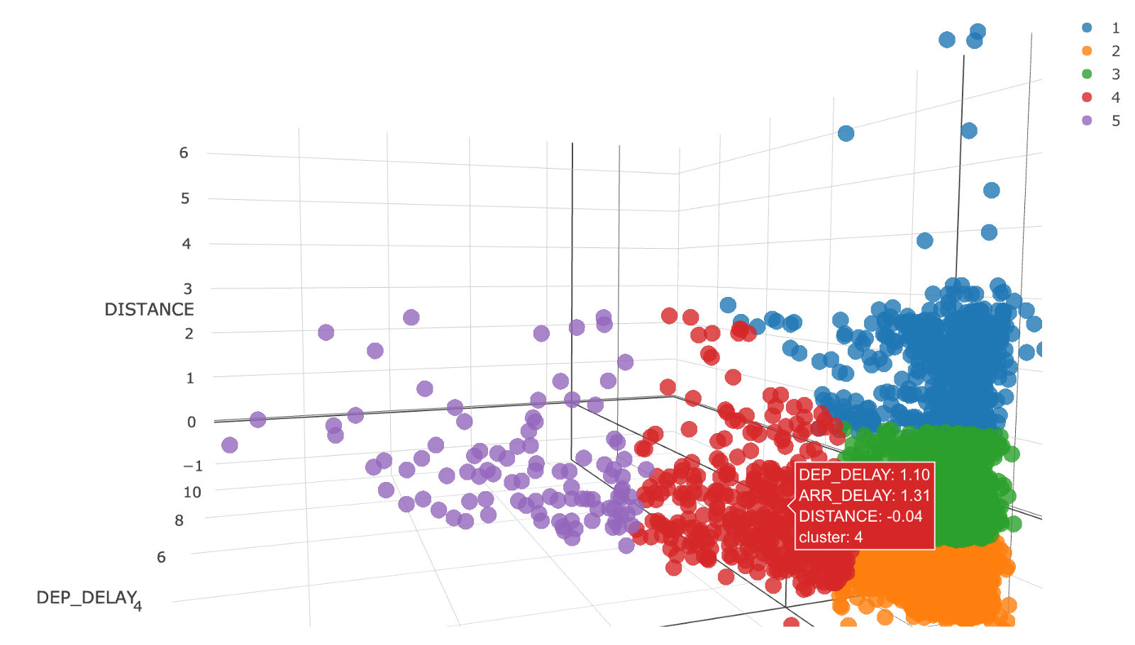
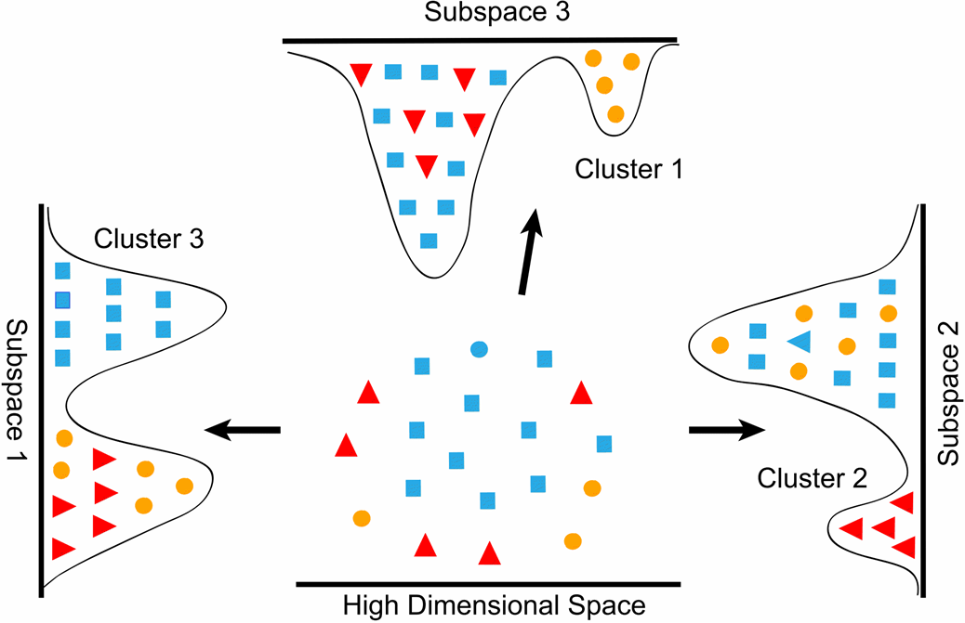
Problem Types-Unsupervised Learning
Clustering
Dimension Reduction

Slide 8

Three Elements of Statistical Learning
Model
Risk Function
Algorithm

Slide 9

Classification as an example-Iris data set
How to approach a problem from a statistical learning perspective?
  What’s the data? What’s the unknown? What’s the condition?
  What’s the problem type?
  What key statistical learning algorithm I choose to use?

Slide 10
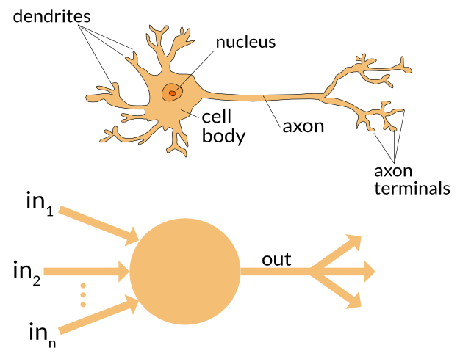
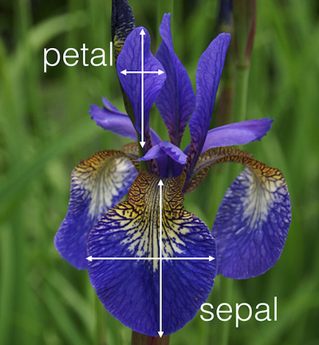
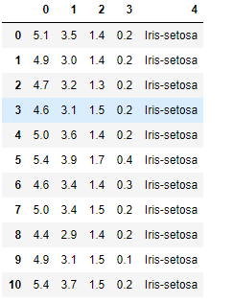
How to further approach this problem?
Features to use
Data we have
Models we choose

Slide 11


Lab and our tools
Run through all the code in the lecture0_lab notebook
Describe how you will improve the solution in the notebook
Try to write all the code again by yourself

Slide 12
Homework and further reading
Try creating a 5*10 data frame
Think of 3 real world examples in each of four problem types
Think of an example when interpretability is more important than prediction accuray
Try to use a new package in sklearn to classify the iris dataset
Introduction to Statistical Learning by Trevor Hastie and Robert Tibshirani
《机器学习》第一章、第二章 周志华

